Slide 1
Gauss’s Law

Slide 2
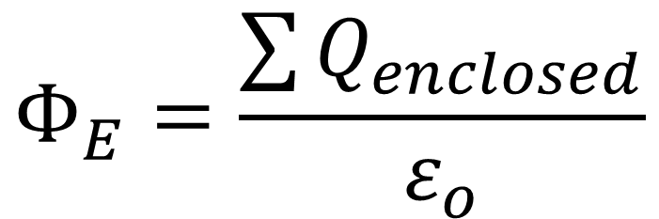
General form of Gauss’s law
Gauss’s law states that the total electric flux through a closed surface is equal to the total (net) electric charge inside the surface, divided by permittivity of free space, ε_{o.}
$$Φ_{E}=\frac{\sum{Q_{enclosed}}}{ε_{o}}$$

Slide 3
r
θ = 0
cosθ = 1
+
SYMMETRY ARGUMENTS
1. The magnitude of the electric field is the same at any point
2. If there is an electric field, it must point either radially outwards or radially inwards

Slide 4
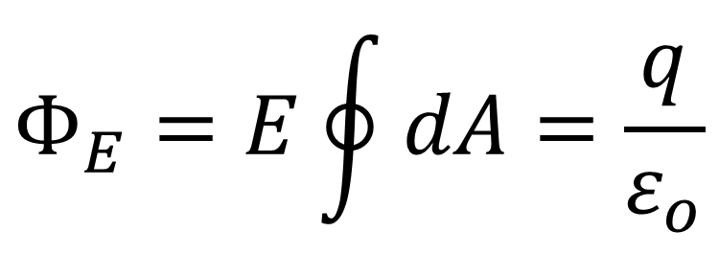
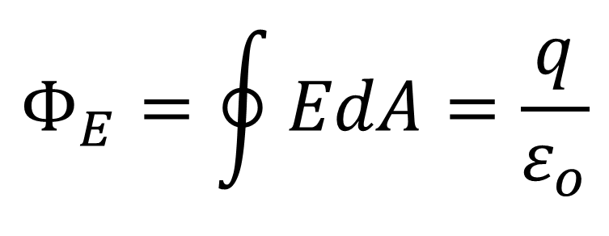
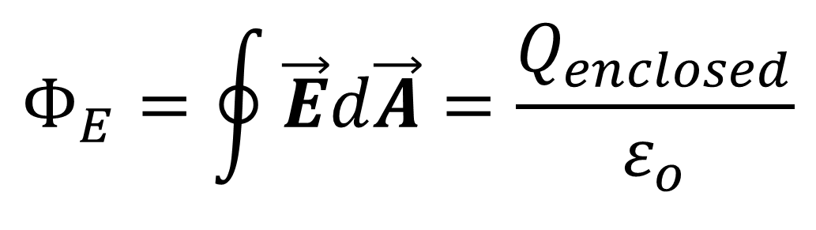
$$Φ_{E}=\oint{\vec{E}d\vec{A}=\frac{Q_{enclosed}}{ε_{o}}}$$
r
θ = 0
cosθ = 1
+
$$Φ_{E}=\oint{EdA=\frac{q}{ε_{o}}}$$
E
dA
$$Φ_{E}=E\oint{dA=\frac{q}{ε_{o}}}$$

Slide 5
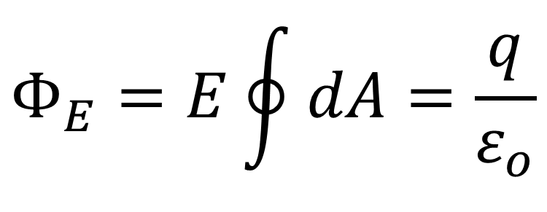
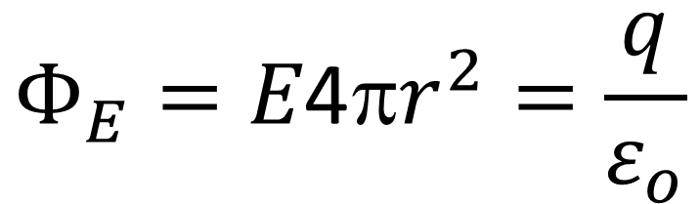
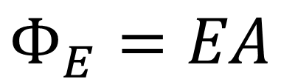
$$Φ_{E}=\oint{\vec{E}d\vec{A}=\frac{Q_{enclosed}}{ε_{o}}}$$
$$Φ_{E}=E\oint{dA=\frac{q}{ε_{o}}}$$
r
+
$$Φ_{E}=EA$$
A = 4πr²
$$Φ_{E}=E\text{4π}r^{2}=\frac{q}{ε_{o}}$$
E
dA

Slide 6
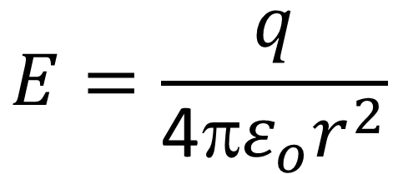
$$Φ_{E}=\oint{\vec{E}d\vec{A}=\frac{Q_{enclosed}}{ε_{o}}}$$
r
$$E=\frac{q}{{\text{4π}ε}_{o}r^{2}}$$
+
E
dA

Slide 7
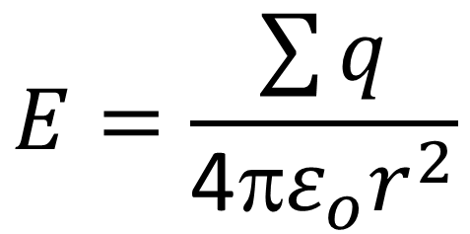
$$Φ_{E}=\oint{\vec{E}d\vec{A}=\frac{Q_{enclosed}}{ε_{o}}}$$
r
$$E=\frac{\sum{q}}{{\text{4π}ε}_{o}r^{2}}$$
+
+
+
+
+
E
dA

Slide 8
Field of a charged conducting sphere
All of the charge must be on the surface of the sphere. The charge is free to move on the conductor, and there is no preferred position on the surface; the charge is therefore distributed uniformly over the surface, and the system is spherically symmetric.
r
r

Slide 9
Field of a charged conducting sphere
The spherical symmetry means that the direction of the electric field must be radial; that’s because there is no preferred direction parallel to the surface, so E can have no component parallel to the surface.
r
r

Slide 10
Field of a charged conducting sphere
There is also no preferred orientation of the
sphere, so the field magnitude E can depend only on the distance r from the center and must have the same value at all points on the Gaussian surface.
r
r

Slide 11
$$Φ_{E}=\oint{\vec{E}d\vec{A}=\frac{Q_{enclosed}}{ε_{o}}}$$
For r < R
r
The Gaussian surface (which lies entirely within the conductor) encloses no charge, so Q_{encl} = 0. The electric field inside the conductor is therefore zero.

Slide 12
$$Φ_{E}=\oint{\vec{E}d\vec{A}=\frac{Q_{enclosed}}{ε_{o}}}$$
For r > R, outside a charge sphere
r

Slide 13
$$Φ_{E}=\oint{\vec{E}d\vec{A}=\frac{Q_{enclosed}}{ε_{o}}}$$
For r = R, at the surface a charge conducting sphere

Slide 14
Electric field of a line of charge
R
λ
+
+
+
+
+
+
+
+
+
+

Slide 15
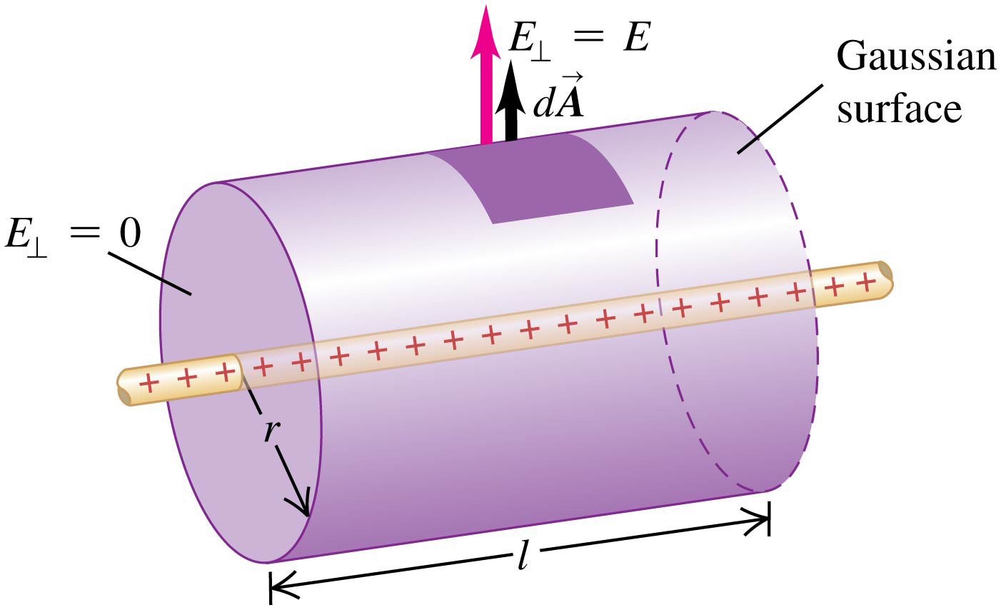
Electric charge is distributed uniformly along an infinitely long, thin wire. The charge per unit length is l (assumed positive). Find the electric field by using Gauss’s law.

Slide 16
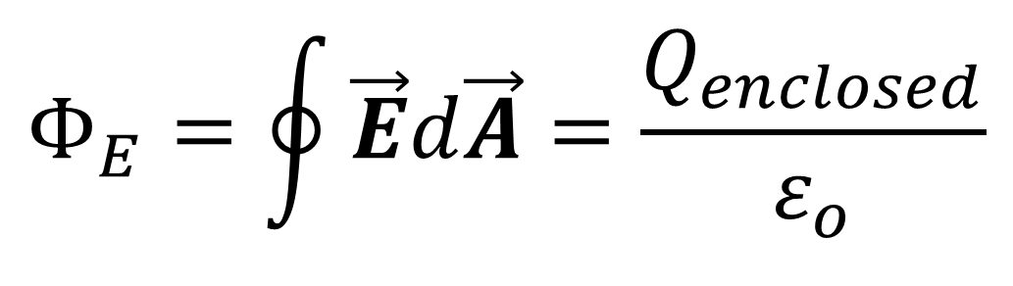
$$Φ_{E}=\oint{\vec{E}d\vec{A}=\frac{Q_{enclosed}}{ε_{o}}}$$
The flux through the flat ends of our Gaussian surface
is zero because the radial electric field is parallel to these
ends

Slide 17
$$Φ_{E}=\oint{\vec{E}d\vec{A}=\frac{Q_{enclosed}}{ε_{o}}}$$
The area of the cylindrical
surface is 2πrl
l
2πr

Slide 18
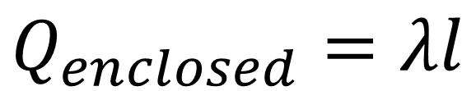
$$Φ_{E}=\oint{\vec{E}d\vec{A}=\frac{Q_{enclosed}}{ε_{o}}}$$
The total enclosed charge is
$$Q_{enclosed}=λl$$

Slide 19
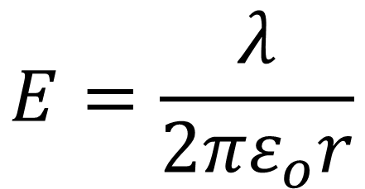
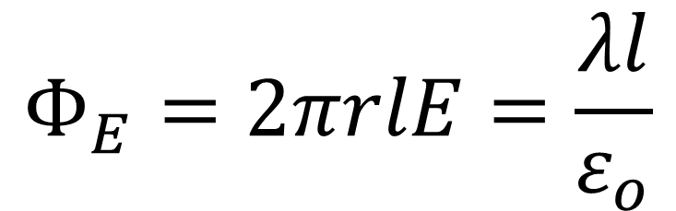
$$Φ_{E}=\oint{\vec{E}d\vec{A}=\frac{Q_{enclosed}}{ε_{o}}}$$
$$Φ_{E}=2πrlE=\frac{λl}{ε_{o}}$$
$$E=\frac{λ}{{2πε}_{o}r}$$
(field of an infinite line of charge)

Slide 20
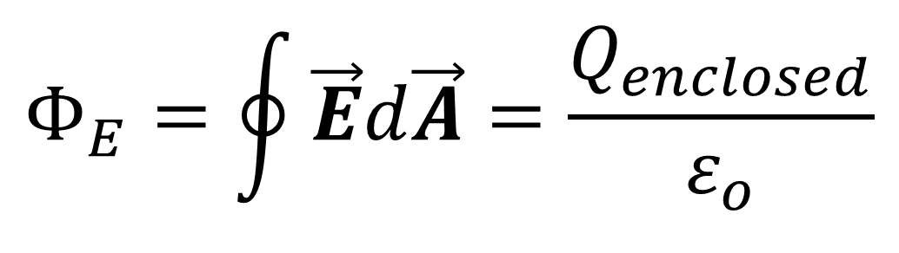
Field of an infinite plane sheet of charge
$$Φ_{E}=\oint{\vec{E}d\vec{A}=\frac{Q_{enclosed}}{ε_{o}}}$$
The flux through the cylindrical part of our Gaussian surface is zero
The flux through each flat end of the surface is +EA
Hence the total flux E through the Gaussian surface—is +2EA.

Slide 21
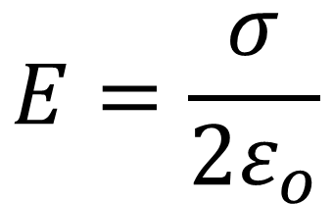
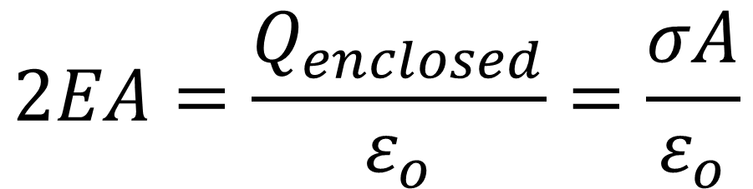
Field of an infinite plane sheet of charge
$$Φ_{E}=\oint{\vec{E}d\vec{A}=\frac{Q_{enclosed}}{ε_{o}}}$$
$$2EA=\frac{Q_{enclosed}}{ε_{o}}=\frac{σA}{ε_{o}}$$
$$E=\frac{σ}{{2ε}_{o}}$$

